Slide 1
MEF UNIVERSITY
Solving TSP Problem with Genetic Algorithm
Presented by Ibrahim Onur Serbetci

Slide 2
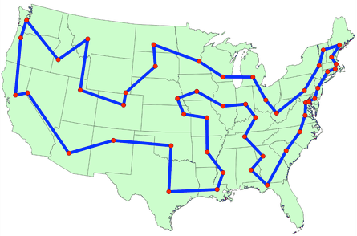
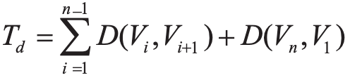
WHAT IS
TSP PROBLEM?
One of the most famous problems in mathematics
It's hard to solve computationally
D(Vi,Vi+1) is distance bitween two cities
Min of target function is objective function

Slide 3

ENCODE
INITIAL POP
Assuming that the number of each city is an integer 1,2,3,...,n.
For example,
{1, 3, 4, 2, 6, 9, 10, 8, 5, 7}
A random function is used to generate an initialization population.

Slide 4
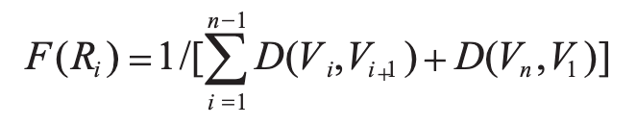
FITNESS FUNCTION
Whether the individual evolution of a population is a better solution to the problem, that is, to see its adaptability, the standard of evaluation is the value of the fitness function.
*Ri represents the path i.

Slide 5
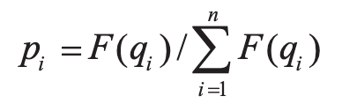
SELECTION OPERATION
The selection operation is to generate a new population with higher values of the fitness function from the current population by a certain selection probability.
*qi represents the each genome in current population.

Slide 6
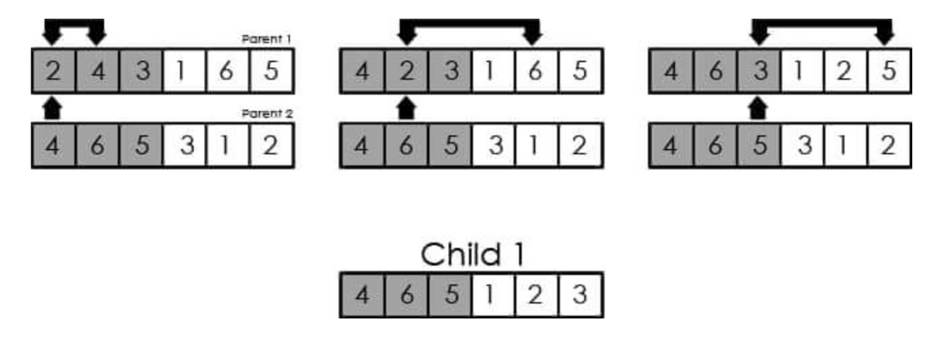
CROSSOVER OPERATION
Partial crossover method can ensure that the high-quality chromosomes can be inherited to the next generation, which is conducive to improving the performance of genetic algorithm.

Slide 7
SIMULATION EXPERIMENTS AND RESULTS
IN TWO LANGUAGES
NOTICEABLY DECREASING
Runned in two programming languages which are python and java then results are saved.
Objective function is decreasing meanly 17,72%.

Slide 8
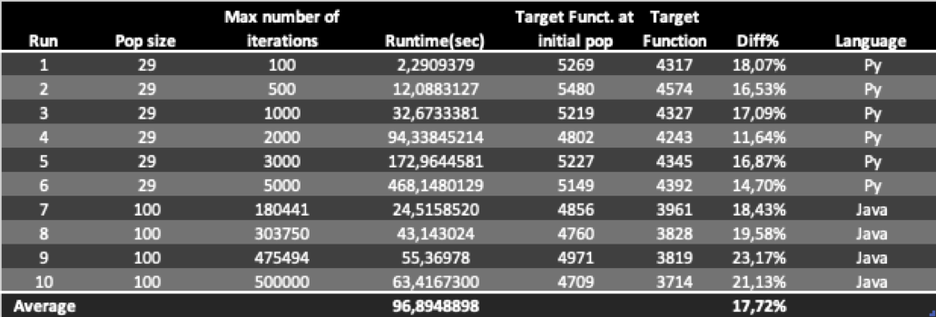
FIGURE 1. RUN SOLUTIONS BY DIFFERENT PARAMETERS
TARGET
RUNTIME
Target function result is decreasing by genetic algorithm.
Average runtime is 96,89 seconds.

Slide 9
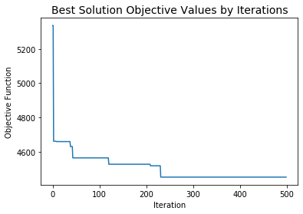
RESULT
In 500 iteration run, target function result is decreasing exponentially and stalling more than 250 iterations.

Slide 10

REFERENCES
Fu, C., Zhang, L., Wang, X. and Qiao, L., 2018. Solving TSP problem with improved genetic algorithm.
Stack Abuse. 2020. Traveling Salesman Problem With Genetic Algorithms In Java. [online] Available at: <https://stackabuse.com/traveling-salesman-problem-with-genetic-algorithms-in-java/> [Accessed 22 April 2020].

Slide 11
THANK YOU!
IBRAHIM ONUR SEBETCI

